Slide 1
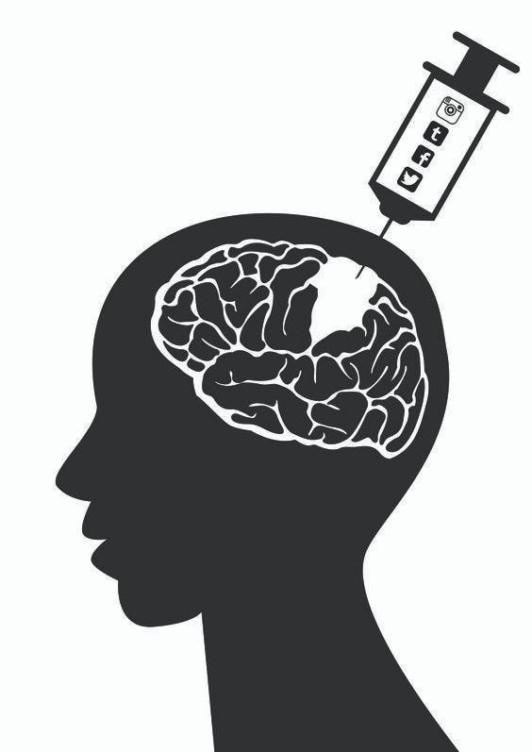
Impact of Social Media usage on Mental Health A Data-Driven Analysis of Social Media Usage and Psychological Well-being M.Sc. Data Science(60 ECTS) Department of Data Science Guided By: Prof.Farhan Khan
Team Members
DEEPIKA
Team Lead & Documentation
SRIVIDHYA
Data Collection & Dataset Handling
GANESH
Data Cleaning & Preprocessing
BHUWAN
Data Analysis & Visualization
VRINDA SUNI
PPT Design GitHub Presentation

Slide 2




Problem Statement
Why this project?
Social media platforms have become an integral part of daily life. While they improve communication and connectivity, excessive usage may contribute to mental health issues such as anxiety, depression, stress, sleep disturbances, and reduced self-esteem.
The Impact Path
Increased screen time among youth
Social Media Usage
Rising mental health concerns
Key Problems
Behavioural Changes
Lack of awareness about usage patterns
Mental Health Impact
Need for data-driven insights

Slide 3


Project Objective
Main Objective
To analyse how social media usage influences mental health and identify patterns that may indicate psychological well-being or distress.
Specific Objectives
Analyze user behavior
Identify correlations between
social media activity and mental health
1
4
Study screen time patterns
Generate meaningful insights through data analysis
2
5
Examine emotional and psychological indicators
3

Slide 4

Data Representation
Dataset Overview
📊 Source: Kaggle – Social Media and Mental Health Dataset
👥 Records: 1000+ Users
📋 Features: 15–20 Attributes
🎯 Purpose: Analyse the relationship between social media usage and
mental well-being
Key Variables
👤 Age, Gender
📱 Platform Used
⏰ Daily Usage Hours
😴 Sleep Duration
🧠 Stress & Anxiety Levels
😊 Well-being Score
User id | Age | Platform | Usage Hours | Sleep Hours | Stress Level
001 | 21 | Instagram | 4.5 | 6.0 | High
002 | 24 | Facebook | 2.0 | 7.5 | Low
003 | 22 | TikTok | 5.0 | 5.5 | high
data Flow : Raw Data → Cleaning → EDA → Visualization → Insights

Slide 5



Methodology / How We Are Working
Workflow
Tools Used
Python
Pandas
NumPy
Seaborn
Data Collection
Data Preprocessing
Exploratory Data Analysis (EDA)
Statistical Analysis
Visualization & Interpretation
Result Generation
Flow Diagram
Dataset
Cleaning
Analysis & Visualization
Insights

Slide 6

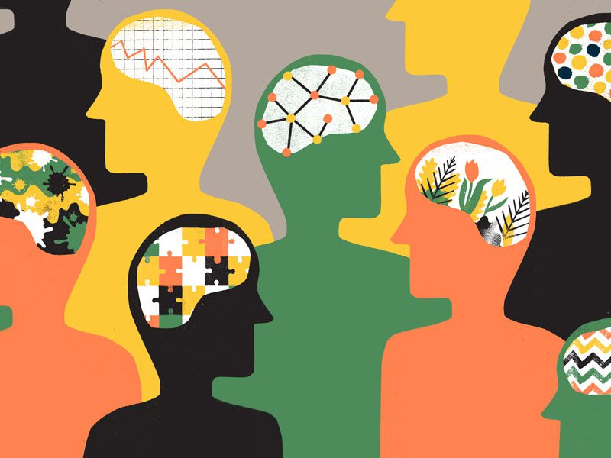
Expected Outcomes
Understand social media usage trends
Identify factors affecting mental health
Discover relationships between screen time and psychological well-being
Generate visual insights for awareness
Provide data-supported recommendations
Expected Deliverables
✔ Analytical Dashboard
✔ Visual Reports
✔ Research Findings
✔ Final Project Documentation

Slide 7
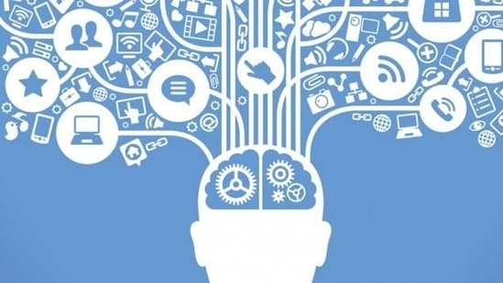
Conclusion & Future Scope
Conclusion
This project aims to provide a comprehensive understanding of how social media influences mental health using data-driven analysis. The findings can help users, educators, and researchers better understand digital behaviour and its psychological impact.
Future Scope
Real-time monitoring system
Machine Learning prediction models
Mental health risk detection
Personalized recommendations

Slide 8
ANY QUESTIONS?
thank you for your attention
Ganesh | Deepika | bhuwan | srividhya | vrinda

